Slide 1
Encoding Apocalypse and Empire: Online Editions of Rev 17:1–18:24 and 21:1–22:7 and the Display of Intertextual Allusions
C. Thomas Fraatz
Boston College
tinyurl.com/apocalypseandempire

Slide 2
Revelation as Apocalypse and Prophecy
A revelation of Jesus Christ which God granted to him to show to his servants the things which must happen soon, and he made it known by sending his angle to his servant John… Blessed is the one who reads and those who hear the words of prophecy and keep the things which are written in it, for the time is near.”
Ἀποκάλυψις Ἰησοῦ Χριστοῦ, ἣν ἔδωκεν αὐτῷ ὁ Θεός, δεῖξαι τοῖς δούλοις αὐτοῦ ἃ δεῖ γενέσθαι ἐν τάχει, καὶ ἐσήμανεν ἀποστείλας διὰ τοῦ ἀγγέλου αὐτοῦ, τῷ δούλῳ αὐτοῦ Ἰωάνῃ… Μακάριος ὁ ἀναγινώσκων καὶ οἱ ἀκούοντες τοὺς λόγους τῆς προφητείας καὶ τηροῦντες τὰ ἐν αὐτῇ γεγραμμένα· ὁ γὰρ καιρὸς ἐγγύς.

Slide 3
A Taxonomy of Intertextuality
Quotation
Allusion
Thematic parallel

Slide 4
Quotation: The use of a pre-existing phrase, sentence, or paragraph which is taken from another source
Amos 1:2 | Joel 4:16 (ET 3:16)
וַיֹּאמַר יְהוָה מִצִּיּוֹן יִשְׁאָג וּמִירוּשָׁלִַם יִתֵּן קוֹלוֹ וְאָבְלוּ נְאוֹת הָרֹעִים וְיָבֵשׁ רֹאשׁ הַכַּרְמֶל | וַיהוָה מִצִּיּוֹן יִשְׁאָג וּמִירוּשָׁלִַם יִתֵּן קוֹלוֹ וְרָעֲשׁוּ שָׁמַיִם וָאָרֶץ וַיהוָה מַחֲסֶה לְעַמּוֹ וּמָעוֹז לִבְנֵי יִשְׂרָאֵל
And he said: The LORD roars from Zion, and utters his voice from Jerusalem; the pastures of the shepherds wither, and the top of Carmel dries up. | The LORD roars from Zion, and utters his voice from Jerusalem, and the heavens and the earth shake. But the LORD is a refuge for his people, a stronghold for the people of Israel.

Slide 5
Allusion: Intentional reference to another text through the use of extended verbal parallel or “catchwords”
Jeremiah 29:4-5 | Isaiah 65:19a, 21-22
כֹּה אָמַר יְהוָה צְבָאוֹת אֱלֹהֵי יִשְׂרָאֵל לְכָל־הַגּוֹלָה אֲשֶׁר־הִגְלֵיתִי מִירוּשָׁלִַם בָּבֶלָה בְּנוּ בָתִּים וְשֵׁבוּ וְנִטְעוּ גַנּוֹת וְאִכְלוּ אֶת־פִּרְיָן | כִּי־אִם־שִׂישׂוּ וְגִילוּ עֲדֵי־עַד אֲשֶׁר אֲנִי בוֹרֵא כִּי הִנְנִי בוֹרֵא אֶת־יְרוּשָׁלִַם גִּילָה וְעַמָּהּ מָשׂוֹשׂ וְגַלְתִּי בִירוּשָׁלִַם וְשַׂשְׂתִּי …וּבָנוּ בָתִּים וְיָשָׁבוּ וְנָטְעוּ כְרָמִים וְאָכְלוּ פִּרְיָם
Thus says the LORD of hosts, the God of Israel, to all the exiles whom I have sent into exile from Jerusalem to Babylon: Build houses and live in them; plant gardens and eat what they produce. | But be glad and rejoice forever in what I am creating; for I am about to create Jerusalem as a joy, and its people as a delight. I will rejoice in Jerusalem…. They shall build houses and inhabit them; they shall plant vineyards and eat their fruit.

Slide 6
Thematic Parallels: Literary devices that a sophisticated author can embed into a text for a sophisticated reader to in order to convey meaning.
Desolated cities being repopulated with wild beasts
Isa 13:21; 34:11-14
Jer 9:10
Nah 3:4
Locusts as a foreign army
Amos 4:9
Joel 1-2
Nah 3:15

Slide 7
Citation Formulae
He left Nazareth and made his home in Capernaum by the sea, in the territory of Zebulun and Naphtali, so that what had been spoken through the prophet Isaiah might be fulfilled: Land of Zebulun, land of Naphtali, on the road by the sea, across the Jordan, Galilee of the Gentiles (Matt: 4:13-15)
As it is written: There is no one who is righteous, not even one” (Rom 3:10)
For there shall be yet another vision concerning the appointed time. It shall tell of the end and not lie. Interpreted, this means that the final age shall be prolonged. If it tarries, wait for it… (1QpHab vii 6-10)

Slide 8
Greek Textforms?
Rev 1:4-5 | Exod 3:14 LXX | Ps 88:37-38 LXX
χάρις ὑμῖν καὶ εἰρήνη ἀπὸ ὁ ὢν καὶ ὁ ἦν καὶ ὁ ἐρχόμενος καὶ ἀπὸ τῶν ἑπτὰ πνευμάτων ἃ ἐνώπιον τοῦ θρόνου αὐτοῦ καὶ ἀπὸ Ἰησοῦ Χριστοῦ, ὁ μάρτυς, ὁ πιστός, … | καὶ εἶπεν ὁ θεὸς πρὸς Μωυσῆν ἐγώ εἰμι ὁ ὤν καὶ εἶπεν οὕτως ἐρεῖς τοῖς υἱοῖς Ισραηλ ὁ ὢν ἀπέσταλκέν με πρὸς ὑμᾶς | τὸ σπέρμα αὐτοῦ εἰς τὸν αἰῶνα μενεῖ καὶ ὁ θρόνος αὐτοῦ ὡς ὁ ἥλιος ἐναντίον μου καὶ ὡς ἡ σελήνη κατηρτισμένη εἰς τὸν αἰῶνα καὶ ὁ μάρτυς ἐν οὐρανῷ πιστός.
Grace to you and peace from the one who is and the one who was, and the one who is coming, and from the seven spirits which are before his throne, and from Jesus Christ, the faithful witness, … | And God said to Moses “I am the one who is.” And he said “Thus you will say to the Israelites, ‘The one who is has sent me to you.’” | His seed shall remain forever, and his throne [will be] as the sun before me and as the moon which is established forever, and it will be a faithful witness in the heavens.

Slide 9
Hebrew Textforms?
Rev 18:4b | Jer 28:45 LXX | Jer 51:45a MT
ἐξέλθατε ὁ λαός μου ἐξ αὐτῆς | [Lacking] | צְאוּ מִתּוֹכָהּ עַמִּי וּמַלְּטוּ אִישׁ אֶת־נַפְשׁוֹ מֵחֲרוֹן אַף־יְהוָה
Come out from her my people! | [Lacking] | Come out from her midst my people!

Slide 10
Density and Brevity
Rev 1:1 | Amos 3:7 | Dan 2:28, 45
A revelation (Ἀποκάλυψις) of Jesus Christ which God granted to him to show to his servants (τοῖς δούλοις αὐτοῦ) the things which must happen (ἃ δεῖ γενέσθαι) soon, and he made it known (ἐσήμανεν) by sending his angle to his servant John… | Surely the Lord GOD does nothing, without revealing (ἀποκαλύψῃ) his secret to his servants (τοὺς δούλους αὐτοῦ) the prophets. (Amos 3:7 NRSV) | but there is a God in heaven who reveals mysteries, and he has disclosed to King Nebuchadnezzar what will happen (ἃ δεῖ γενέσθαι) at the end of days…. The great God has informed (ἐσήμανεν) the king what shall be hereafter. The dream is certain, and its interpretation trustworthy." (

Slide 11
Revelation and the Prophets

Slide 12
Enumerated Allusions

Slide 13
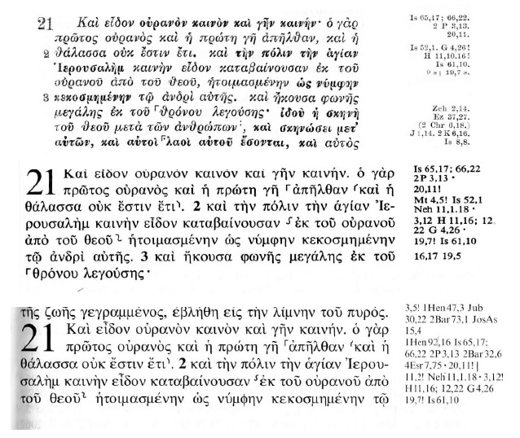
Expanding Allusions

Slide 14
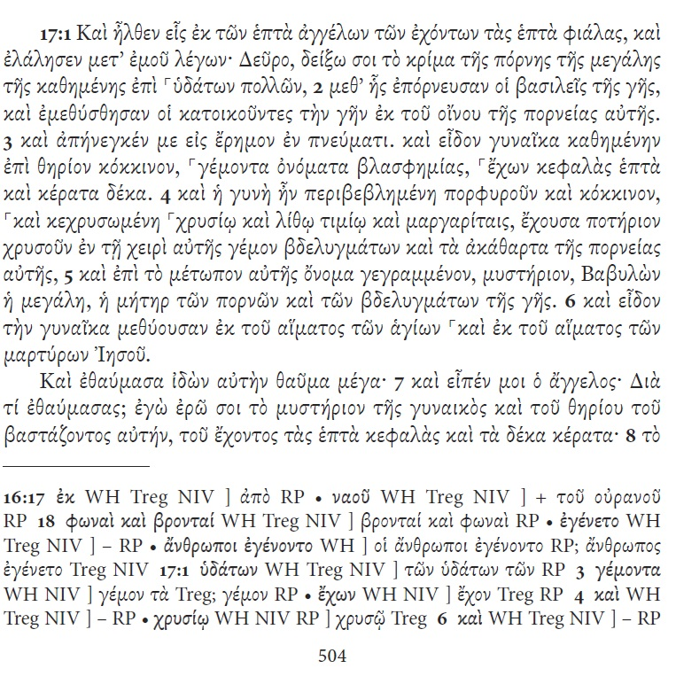
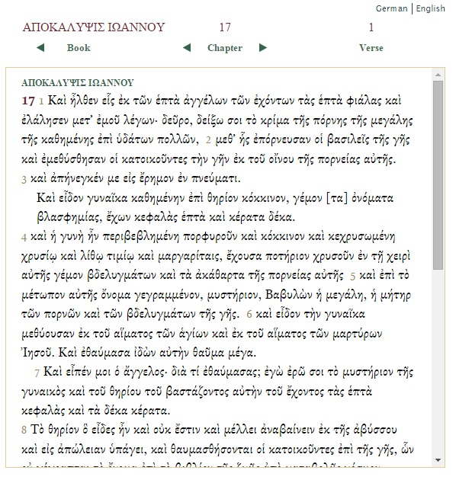
SBLGNT and NA²⁸ Online

Slide 15
Bible Software
Proprietary software options
Powerful
Customization through modular upgrades
Defined tools
Costly
Copyright restrictions
Silos biblical scholarship within the academy

Slide 16
Four Case Studies
Revelation 17:1-6; 18:1-8; 21:22-27; and 22:6-7
http://encodingrevelation.github.io/revelation/revelation/chapter/ap17.html
Or
tinyurl.com/ApocalypseAndEmpire

